Slide 1

Teamfight Tactics
Gameplay Analysis
Andy Li, Colleen Jung, Maya Mireles Rios

Slide 2

01
02
03
04
ABOUT TFT
MODELING
RESULTS
BUSINESS CASE
Description and Industry Review
Modeling Results and Interpretation
Our Objective
Modeling Process

Slide 3
01
Teamfight Tactics
An introduction to the game

Slide 4

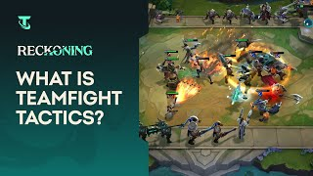
Introduction to Teamfight Tactics (TFT)
Teamfight Tactics (TFT) is an auto battler game, developed by Riot Games, challenges players to think critically, strategize adaptively, and navigate the randomness inherent in each match.
Players compete against seven others to be the last standing, through careful selection and placement of champions, synergizing traits, and optimizing item use.

Slide 5
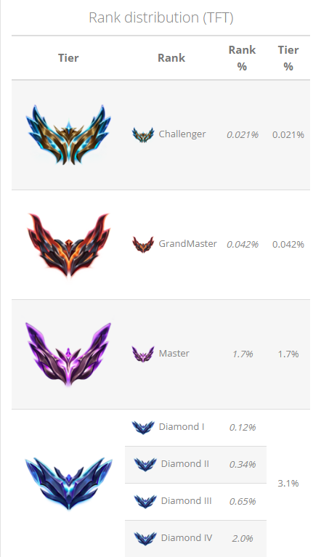
Data Source
The dataset originates from Set 8 of TFT, and focuses specifically on the top-tier player segments within the NA region. Utilizing the Riot Developer API, this collection encompasses endgame statistics from Challenger and Grandmaster ranks—the apex tiers in TFT, representing approximately 5-6% of the global player base.
The dataset featuring 2,296 records from Challenger-ranked matches and 6,392 records from Grand Master-ranked games, offering a detailed insight into the strategies and outcomes of the game's most elite competitors.

Slide 6

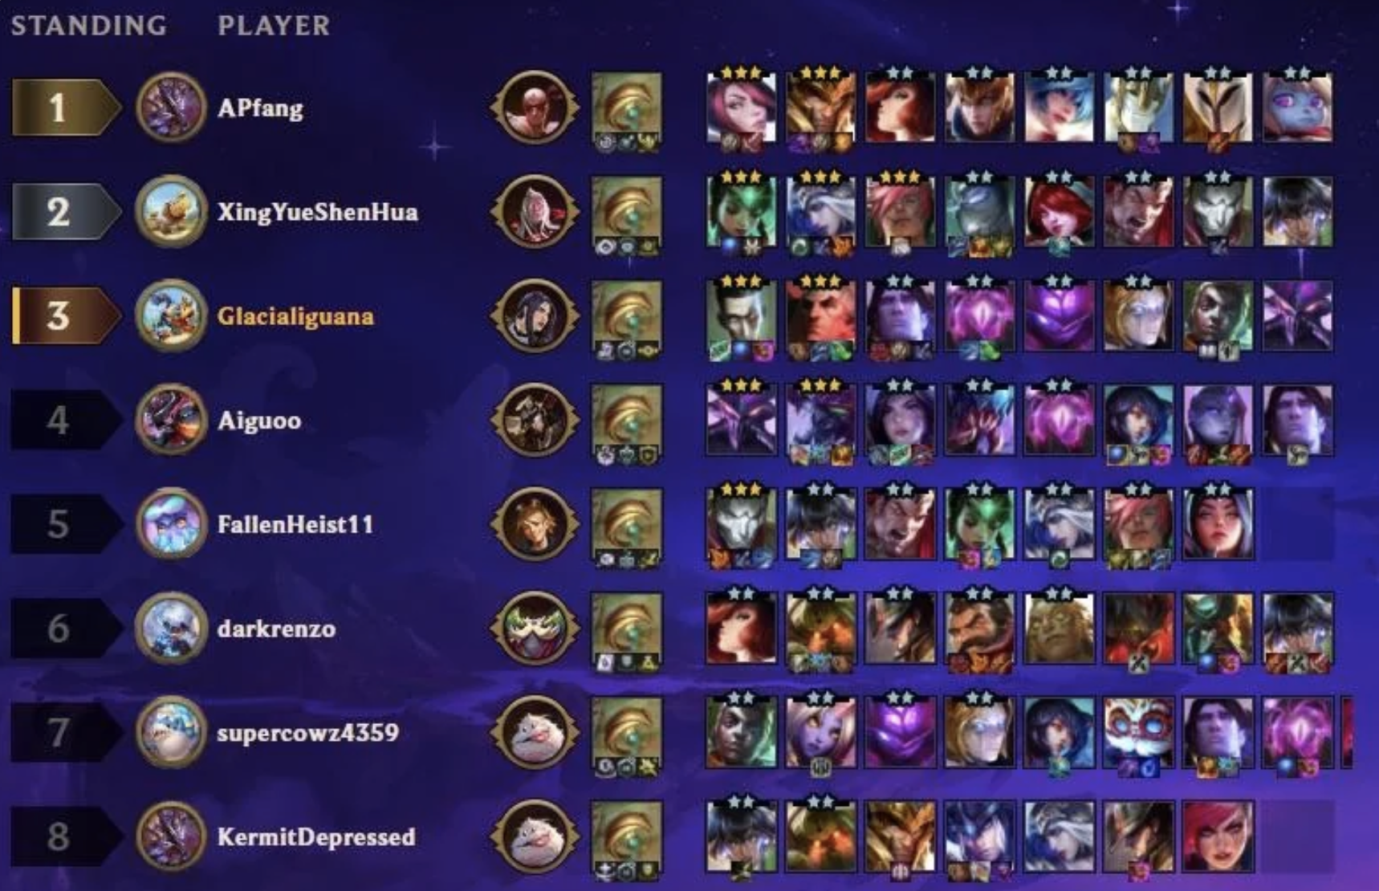
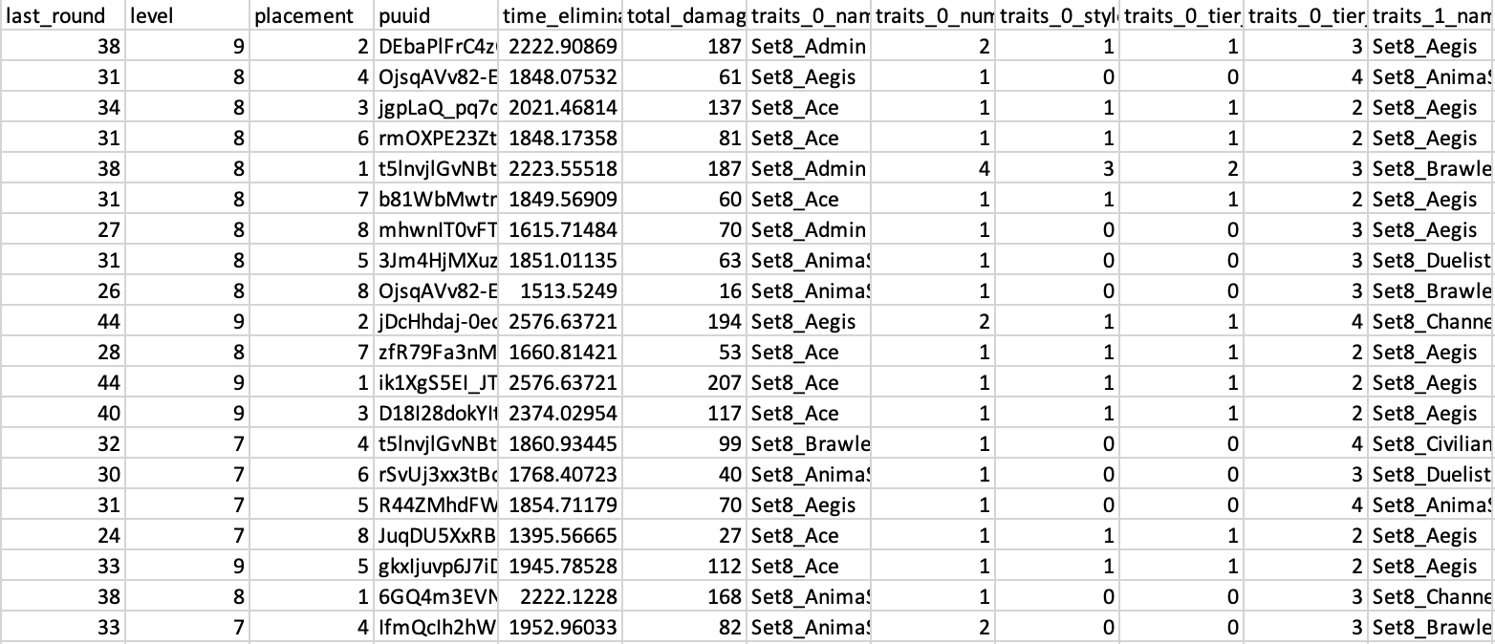
Key Game Features
Placement (Response Variable)
Leveling
In Teamfight Tactics, placement is redefined to categorize players' performance into binary outcomes: winning (1st to 4th place) and losing (5th to 8th place).
The 'level' variable in the dataset is a crucial indicator of a player's progress, influencing both the quantity and quality of champions they can deploy.

Slide 7
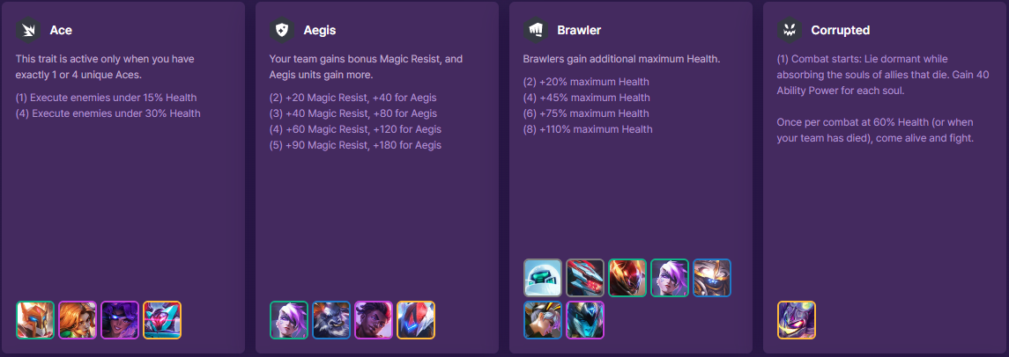
Key Game Features Cont.
Trait Variables
Unit Variables
trait_._name(cat.)
trait_._num(int.)
trait_._tier_current(int.)
trait_._tier_total(int.)
units_._character_id(cat.)
units_rarity(int.): 0-4
units_tier(int.): 1-3

Slide 8
02
BUSINESS CASE

Slide 9
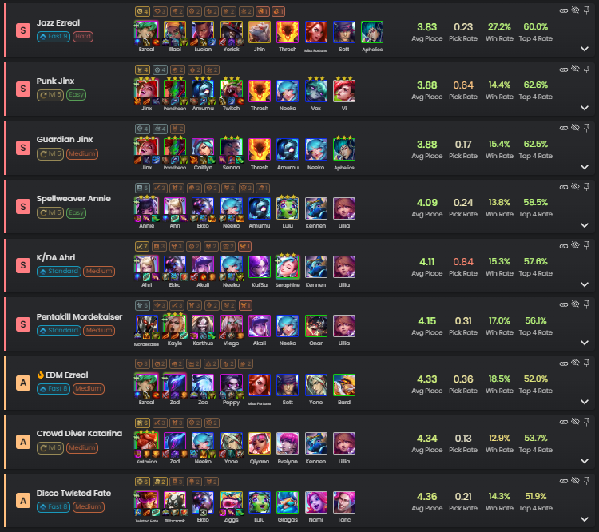
Business Case:
Problem Statement
Existing websites dedicated to analyzing Teamfight Tactics (TFT) predominantly offer descriptive analytics, lacking in-depth model-based analyses.
This project seeks to bridge this gap by developing sufficient prediction models, utilizing numerical variables to uncover effective strategies aimed at achieving top placements, thereby offering valuable insights to players.
Additionally, it aims to assist game developers in fine-tuning game balance through the deployment of predictive models focused on trait and unit importance values.

Slide 10
03
MODELING
Model Development and Model Deployment

Slide 11
MODEL Methodology: Regression vs. Classification
Target?
Regression Model
Continuous distribution – numerical magnitude matters
Suited for ordinal response variables (such as TFT placement scores)
Predictors are easily interpretable
What we are trying to predict:
Win/Lose(Binary)
vs.
Multiclass Classification Model
Discrete distribution – unintuitive for magnitude
Suited for nominal response variables
Predictors are difficult to interpret
Notes:
Explain GridsearchCV, hyperparameter
Add EDA if needed?

Slide 12
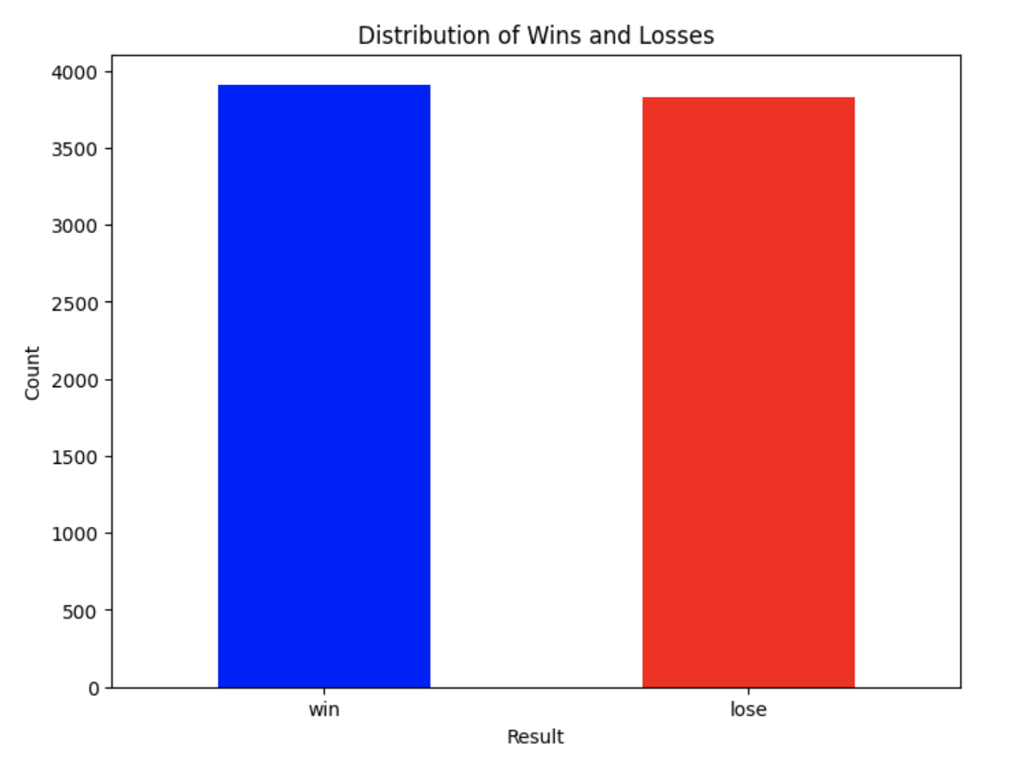
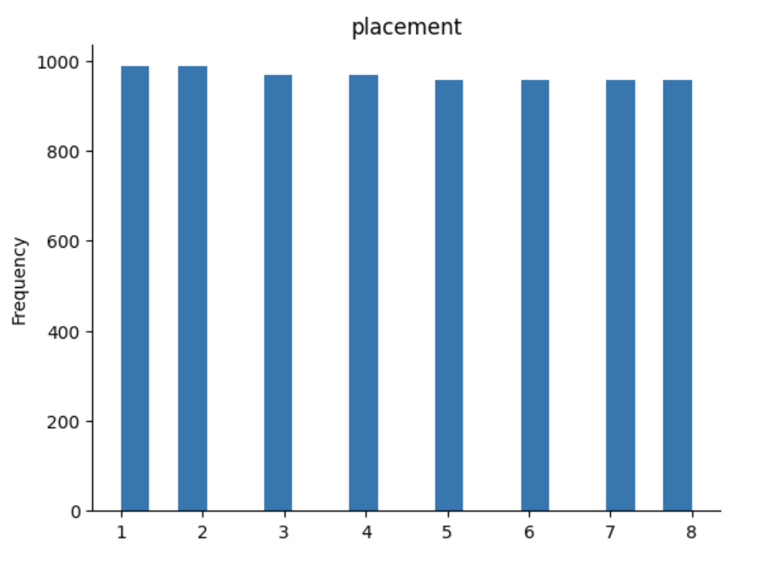
Exploratory analysis shows balanced Target variable
‘Win/Lose’
‘Placement’
Balanced data prevent the model from becoming biased

Slide 13
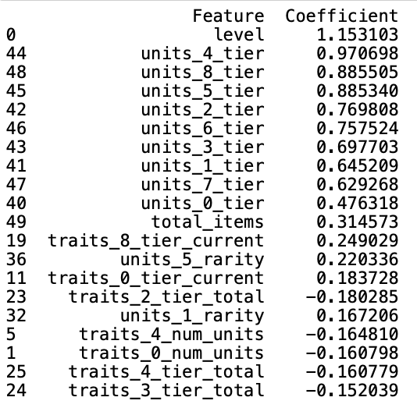
Logistic Regression Coefficients
Drop all categorical variables.
Replace the 'placement' column with binary values for classification.
Get the coefficients of the features

Slide 14
Feature Engineering Ⅰ
Pre-process
Categorical variables
Binning Target variable
GridSearchCV
Model Fit
convert dtypes
fillna
Create Dummy Variable
Via 2 approach:
-One-hot Encoding
-MultiLabelBinarizer
Classification of Placement to Binary:
1-4 -> Lose(0)
or
5-8 -> Win(1)
Find the best combination of hyperparameter that produces the best result
+
Cross-validation
Model 1:
Logistic Regression
Model 2:
XGBoost Classification (One-hot Encoding)
Model 3:
XGBoost Classification
(MultiLabelBinarizer)

Slide 15
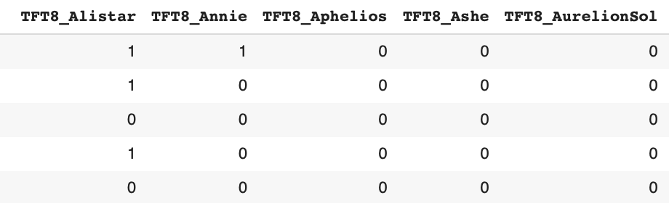
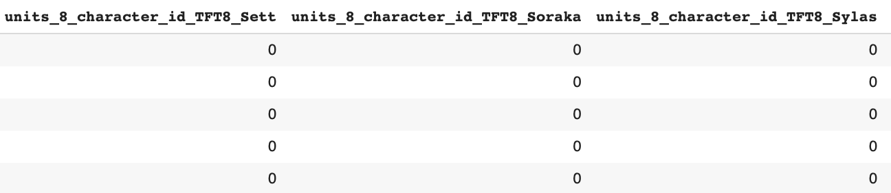
Feature Engineering Ⅱ : Categorical Feature
One-hot Encoding
MultiLabelBinarizer
141 features
⇩
Random Combination
688 features
For model improvement
Combined the item columns into a single list and
convert all the items in a combined list
688 features
⇩
136 features

Slide 16
Model Result- XGBoost Classification outperformed
 | Logistics Regression | XGBoost Classification -OneHotEncode | XGBoost Classification -MultiLabelBinarizer
Accuracy | 0.817 | 0.824 | 0.819
F-1 score | 0.819 | 0.822 | 0.816
Interpretability | Assumes linearity, prone to Overfitting Challenged Feature interpretation, especially mixed set and trait features. | Computational Limit due to large number of ordinal categorical 600+ variables Challenged Feature interpretation | Suitable for binary classification or ordinal categorical variables Precise Feature interpretation

Slide 17
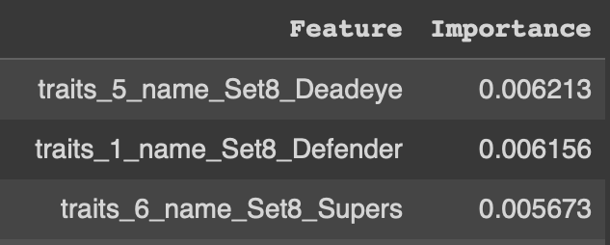
Model Problems
While Model 2 (XGBoost) was a promising model, interpretation by category was overcomplicated
Top 3 most important traits:
Here the traits are ranked along with position, contributing to complicated interpretation
Position
Trait Name

Slide 18
XGBOOST MODEL REVISION
Function used to transform multi-label labels into a binary representation
Combine Units & Traits into a single list columns
2. Apply multilabel binarizer
3. Convert all items in combined list to strings
4. Re-apply multilabel binarizer
Notes:
Multilabel- used to transform multi-label labels into a binary representation for use in machine learning algorithms. It converts a label array of multiple classes into a binary matrix where each column represents one of the possible classes and each row represents an instance

Slide 19
04
RESULTS

Slide 20
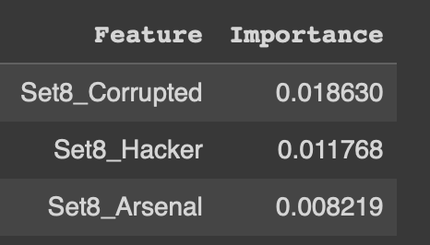
FINAL MODEL
Trait Name
Notes:
Explain GridsearchCV, hyperparameter
Add EDA if needed?

Slide 21

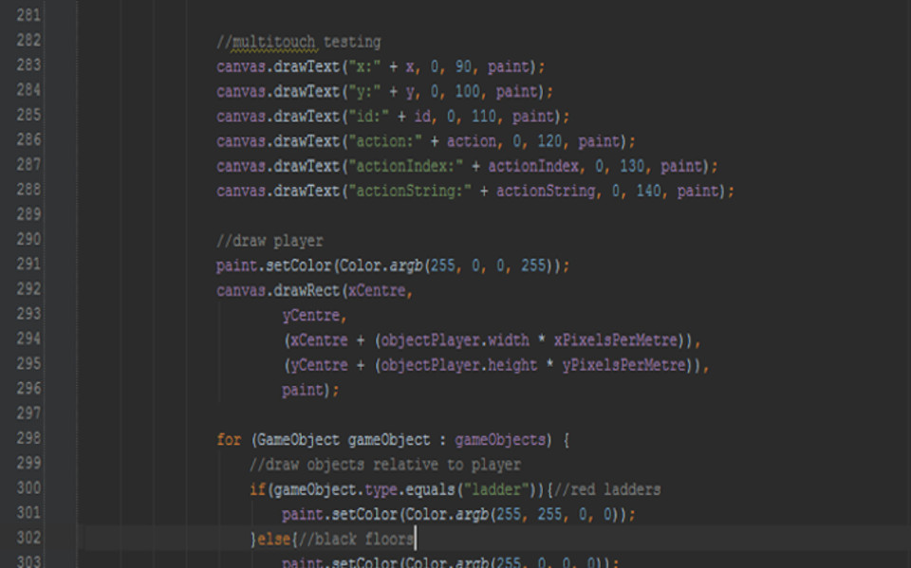
Developer End
Key Takeaways
Why
Developers can modify units/ traits that are over/under powered
Top 3 Units
Top 3 Traits
Lowest 3 Units
Lowest 3 Traits

Slide 22
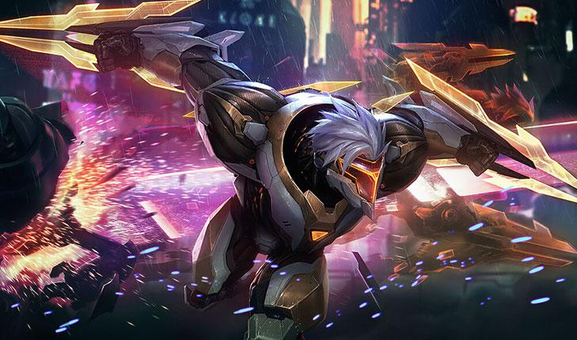
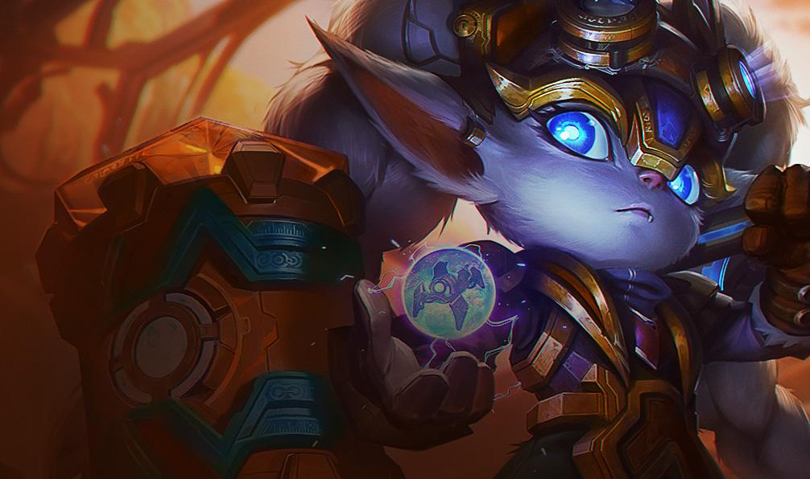
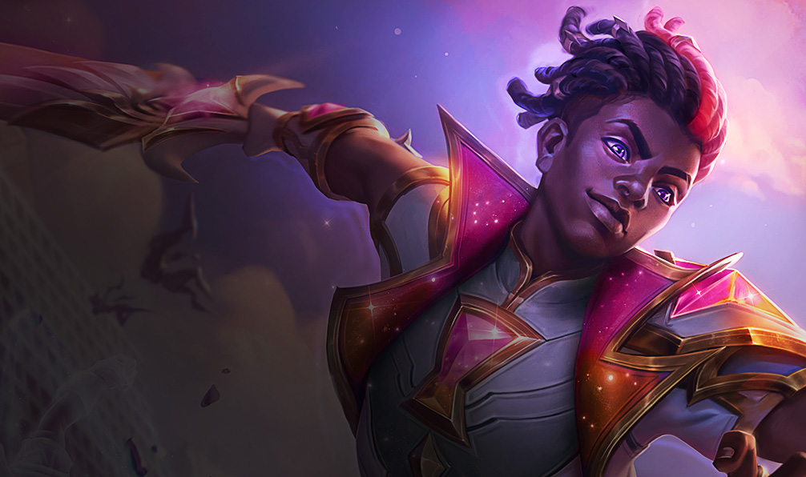
TOP 3 UNITS
2. Zed
Poppy
3. Ekko

Slide 23



TOP 3 TRAITS
2. Hacker
Corrupted
3. Arsenal

Slide 24
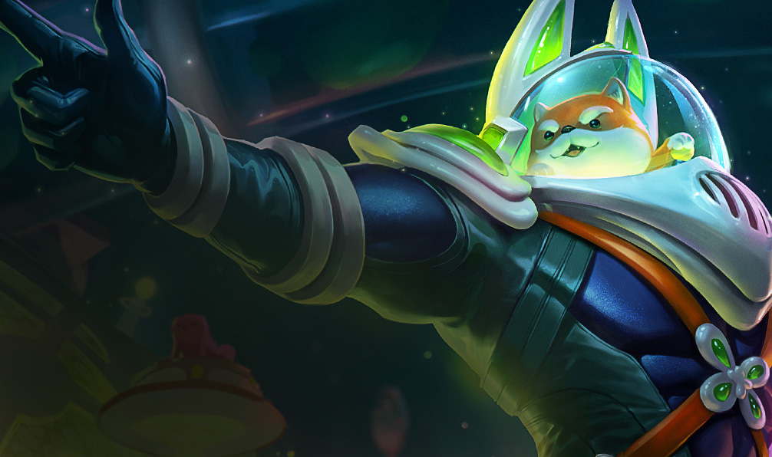
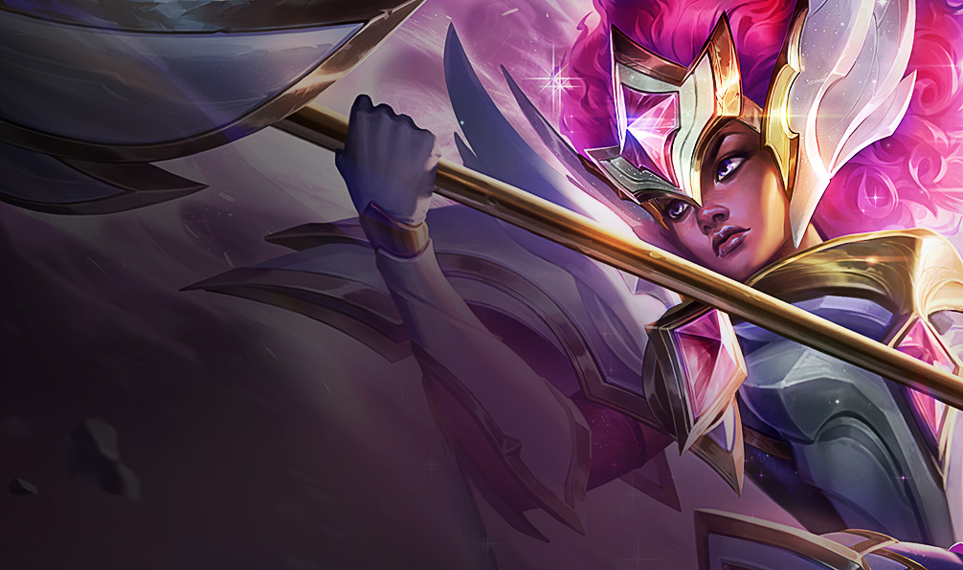
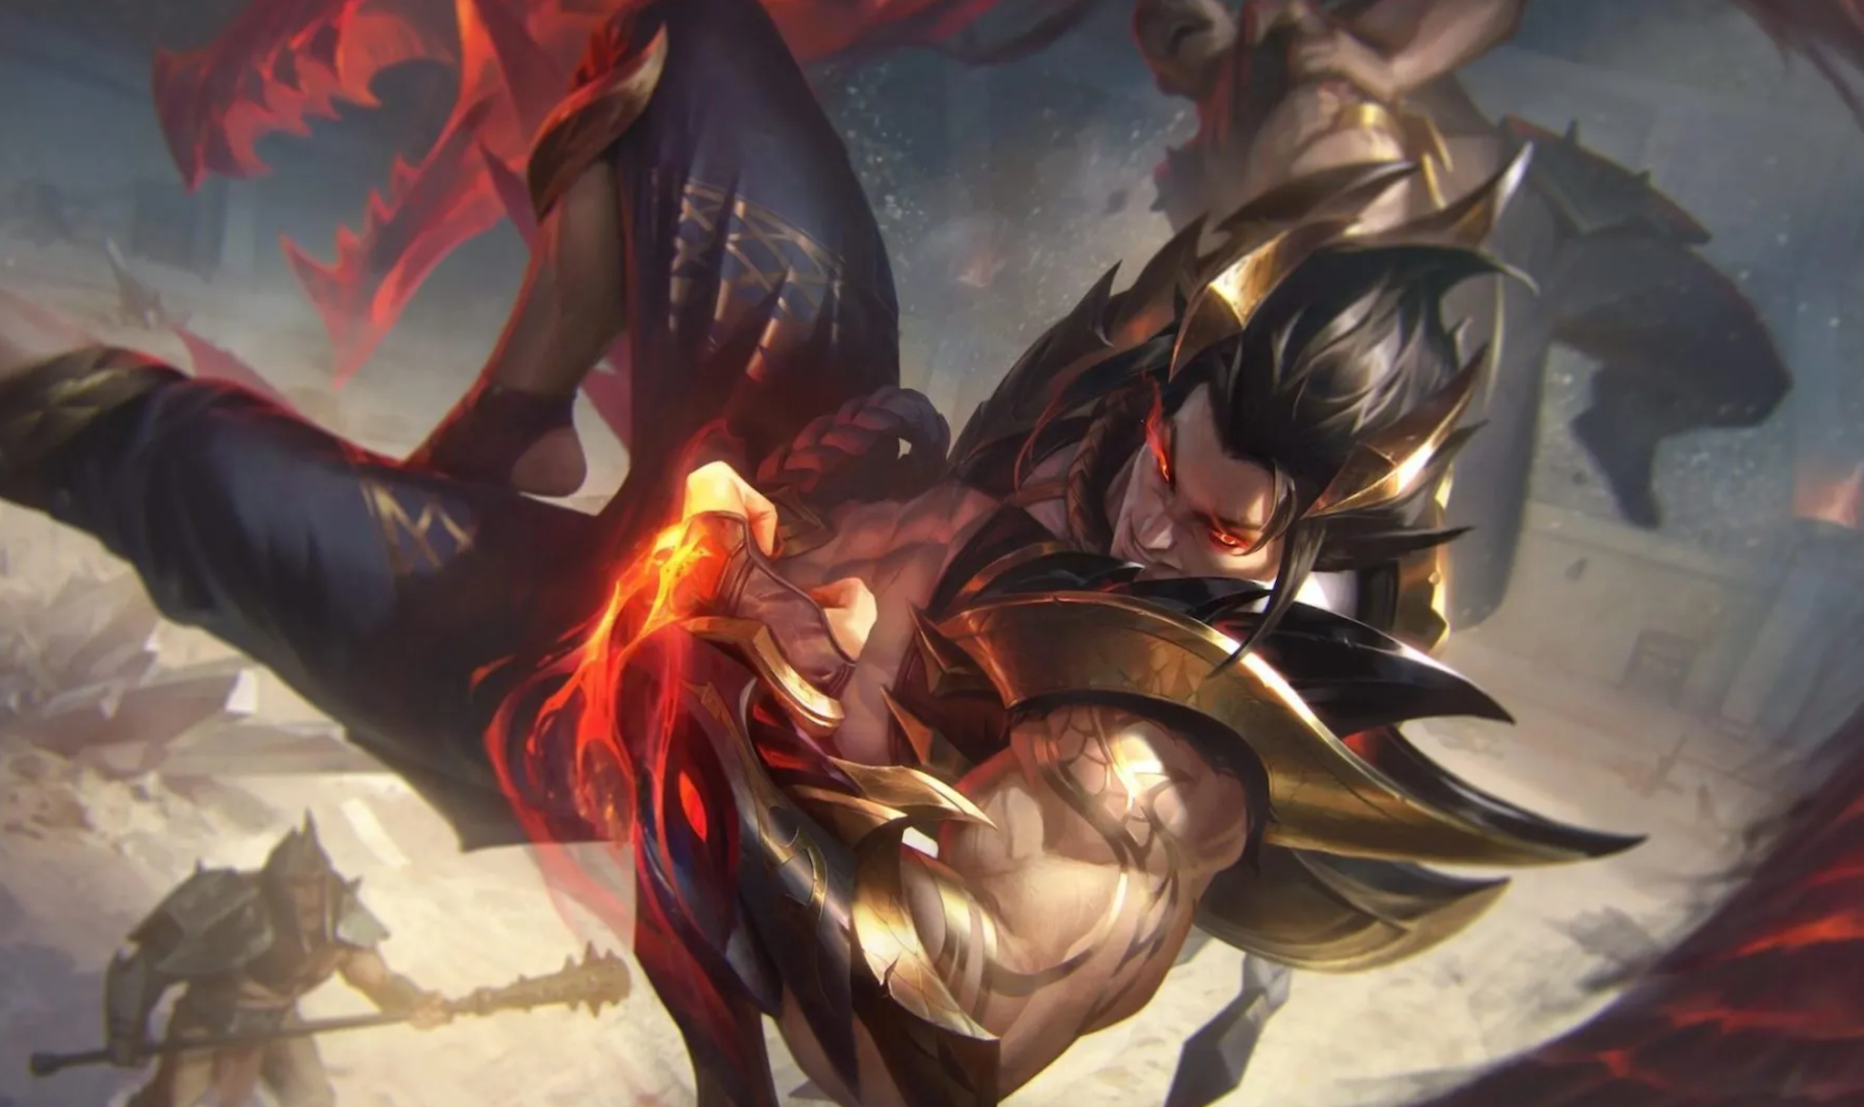
BOTTOM 3 UNITS
*0 feature importance
Nasus
Rell
Sett

Slide 25



BOTTOM 3 TRAITS
*0 feature importance

Slide 26
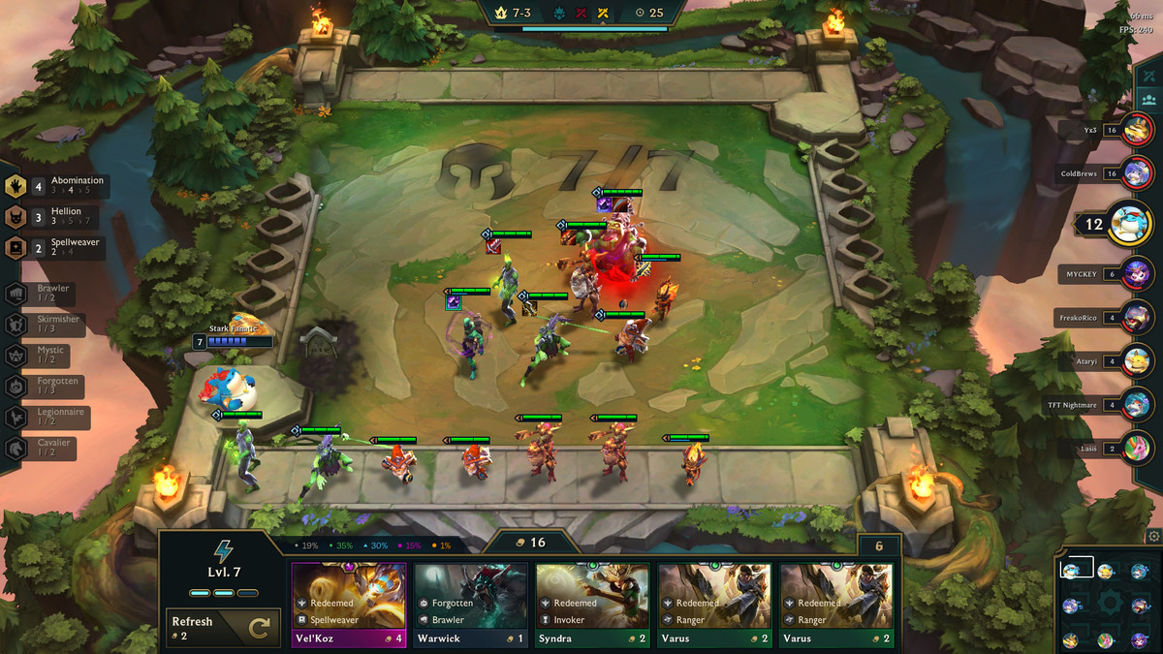
Gamer End
Key Takeaways
Most important features that contribute to a high win rate
Why
Gamers can re-strategize to improve

Slide 27
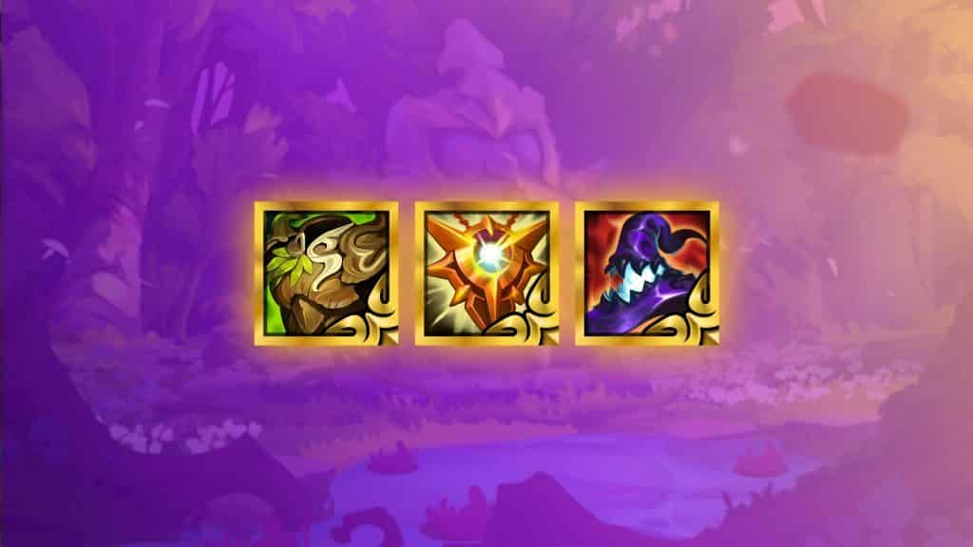
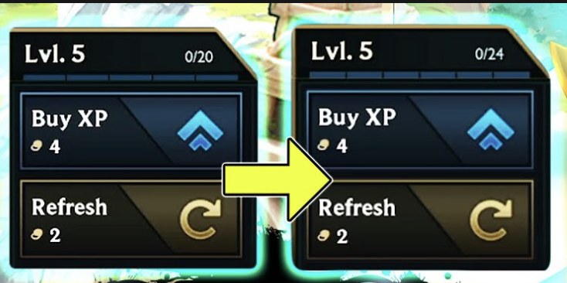
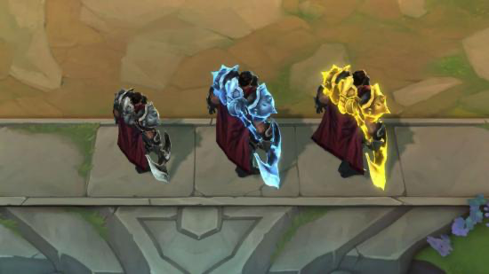
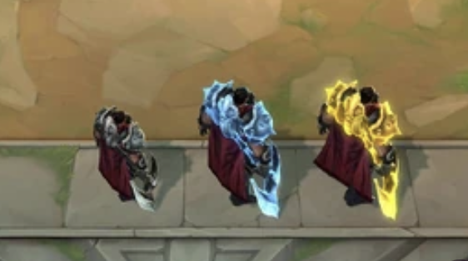
TOP 3 FEATURES
1
Total Items
2
Level
3
Tier

Slide 28
Thank You!

